Slide 2
Presentation Outline
WiFiMon: Introduction & Problem Statement
WiFiMon: Data Flow & Overall Architecture
Data Collection Technology: Crowdsourced & H/W Probe Measurements
TNC 2019 Pilot & Indicative Results
Feedback from TNC19 & 6th SIG-PMV Meeting Audience
Revision & Changes in WiFiMon – Feedback Integration
Future Work

Slide 3
WiFiMon: Introduction
Mission Statement:
“…Is it possible to gather data from multiple sources, including browser-based measurements, in addition to traditional monitoring, and extract meaningful information on the performance of a WiFi network from that data?…”
Development of WiFiMon is supported by the GÉANT GN4-3 project, under the Network Technologies and Services Evolution work package, where European work on perfSONAR is also undertaken

Slide 4
WiFiMon - Problem statement
Measuring and verifying the performance of WiFi networks is challenging.
We have not found any tools that:
Cover all aspects of performance monitoring and verification.
Determine how end-users experience WiFi at a given place on the network,
at a given time.
At present, information for wireless networks can be reported in three ways:
Mobile End-User Device
Wireless Access Points (WAP) / WiFi-Controller
Network Management Systems (NMS)
These sources “only” allow determining if the wireless network is OK overall,
e.g., up/down
H/W probes collect performance measurements but are installed at fixed locations. We can improve our view via crowdsourced measurements.

Slide 5
WiFiMon - Data Flow
Real Time Analysis:
- Performance Data Parsing
Correlation of Performance Data with Accounting Data
Mobility Prediction (Future Work)
- Focus: Network Performance
- Focus: # Users Prediction
PERFORMANCE DATA
ANALYSE DATA
IEEE802.1X / eduroam enabled infrastructures:
- End-users: smartphones, laptops - Hardware Probes: RPi
Filtered RADIUS
Logs
Correlation Results
ACCOUNTING DATA
STORE DATA
CONSUME & VISUALIZE DATA
RADIUS Logs:
- Data Filtering (Logstash)
Data Storage (Elasticsearch) - Filtered RADIUS Logs - Correlated Results (persistent data): Performance Data correlated with RADIUS logs
WiFiMon GUI:
- Visualisation (Kibana) for network administrator
- User Options
5

Slide 6
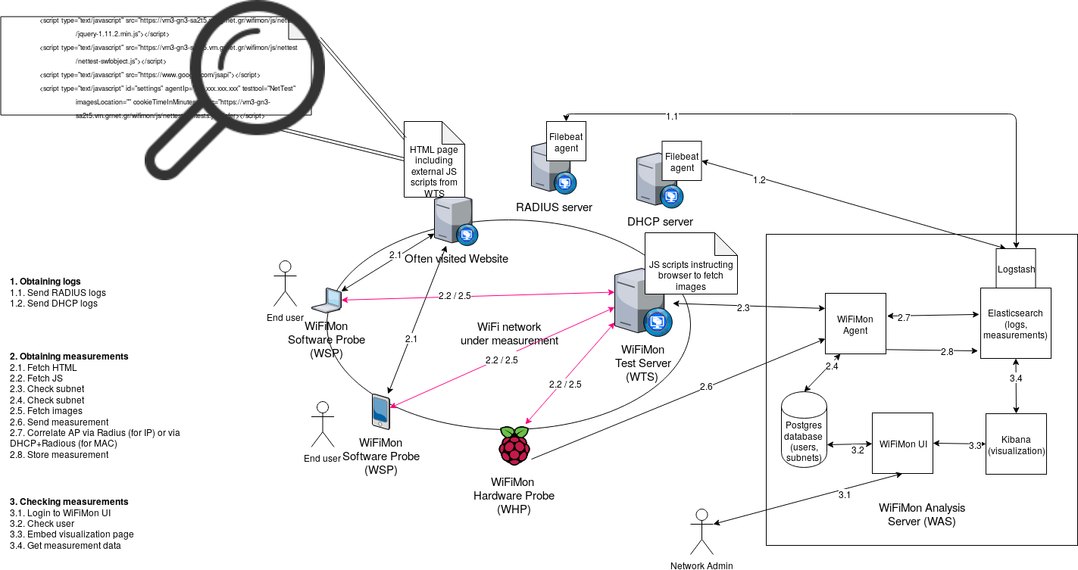
WiFiMon – Overall Architecture
WiFiMon Components:
- WiFiMon Software Probe (WSP) - WiFiMon Test Server (WTS)
- WiFiMon Hardware Probe (WHP) - WiFiMon Analysis Server (WAS)
6

Slide 7
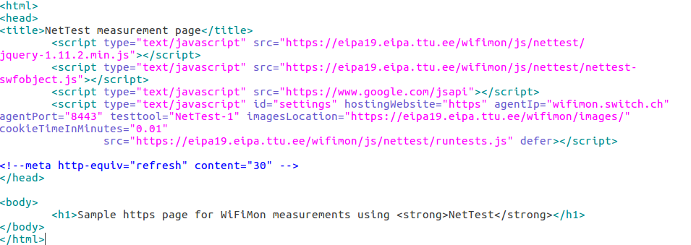
WiFiMon – Data Collection Technology
The end user visits a web page that includes JavaScript code. This triggers measurements.
Available Test Tools: Nettest, Boomerang, Speedtest
The process is collect, store, then (optionally) correlate (this and the next two slides)
User Information

Slide 8
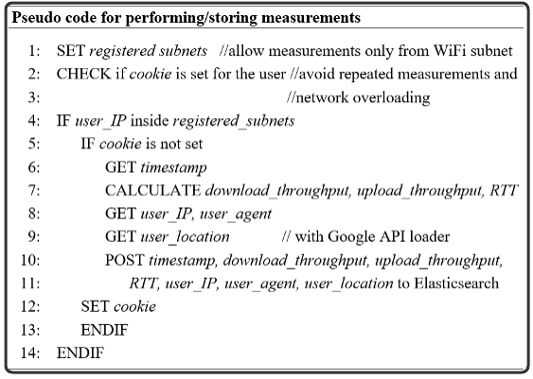
WiFiMon - Performing / Storing measurements
Network Overloading Avoidance:
Measurements accepted only from registered subnets (campus/venue)
Cookie: repeated measurements in short time intervals are not permitted
Default cookie duration is 1.5mins, can be set lower or higher (e.g., down to 0.01min for our TNC pilot)

Slide 9
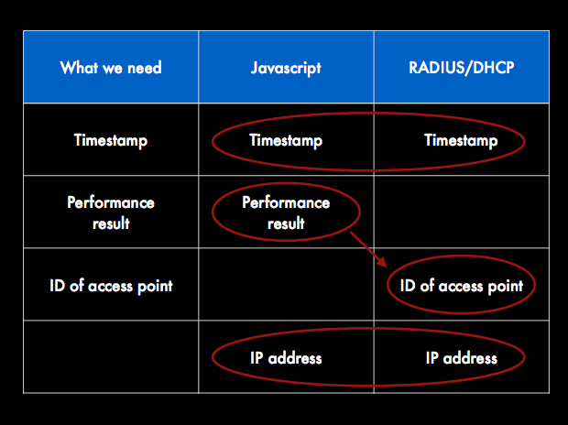
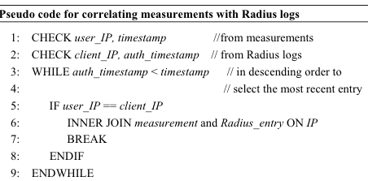
WiFiMon - How we manage/correlate performance data
The aim here is to get the most recent measurement for a given (authenticated) IP.
User IP is from measurements (Javascript)
Client IP is from RADIUS authentication

Slide 10
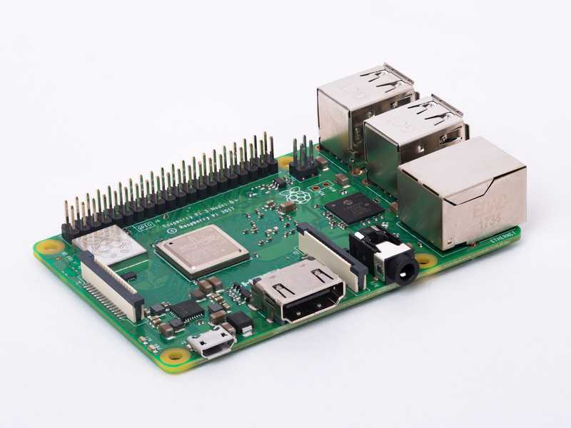
WiFiMon – Hardware Probes
Hardware Probes:
A Raspberry Pi 3 Model B+
A micro SD card with at least 16GB size
WiFiMon Raspberry Pi operating system image
(Size ~ 3.6 GB; available if you contact us for details)

Slide 11
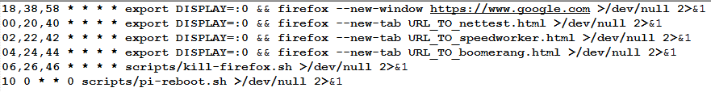
WiFiMon – H/W Probe setup steps
Step 1: Write the image to the micro SD card
Follow the instructions at the official Raspberry Pi site. Skip the "Download the image" step and use the WiFiMon project’s Raspberry Pi operating system image instead.
Step 2: Start the RPi
Insert the microSD in the RPi
Plug the USB keyboard and USB mouse and connect the monitor cable to the Pi's HDMI port
Plug the power supply into a socket and connect it to the micro USB power port
The Pi will boot up into a graphical desktop
Step 3: Configure the RPi
Connect to the wireless network you want to measure.
Set which tests will be executed and how often
A simple crontab (20-minute measurements):

Slide 12
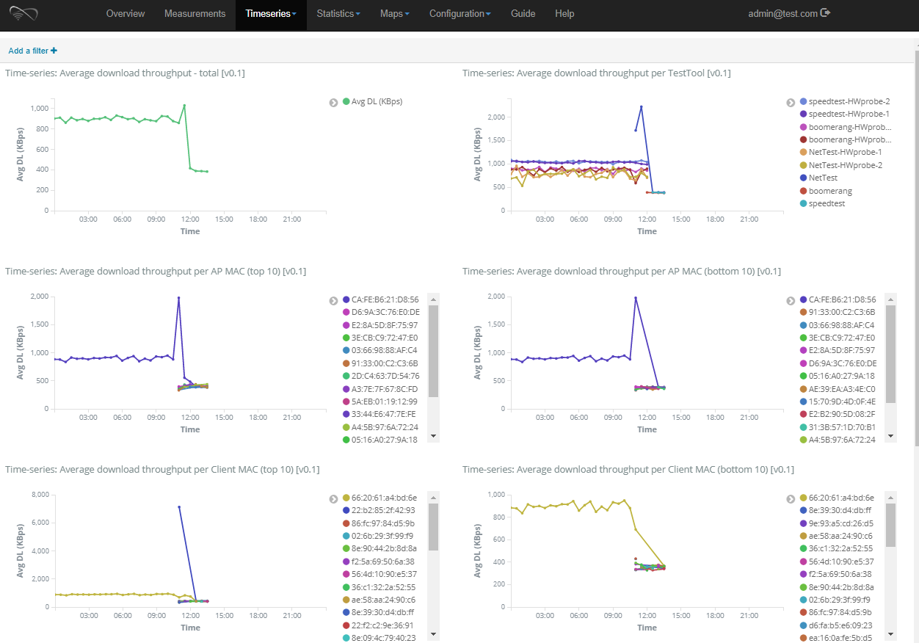
WiFiMon Web-UI (Timeseries Tab of analysis server)

Slide 13
WiFiMon Pilot @ TNC19: Available Equipment
5 Raspberry PI 3 Model B+, 64-bit quad-core ARMv8 CPU, 2.4 & 5 GHz, 802.11b/g/n/ac Wireless LAN, Bluetooth 4.2 & BLE
Laptops & Smartphones of WiFiMon team members
Why did we not include all TNC19 participants (several hundred)?
GDPR issues
WiFiMon was too late to include the required TNC19 privacy notice
Running fuller pilots in the future, e.g., at the GÉANT Symposium, Feb 2020

Slide 14
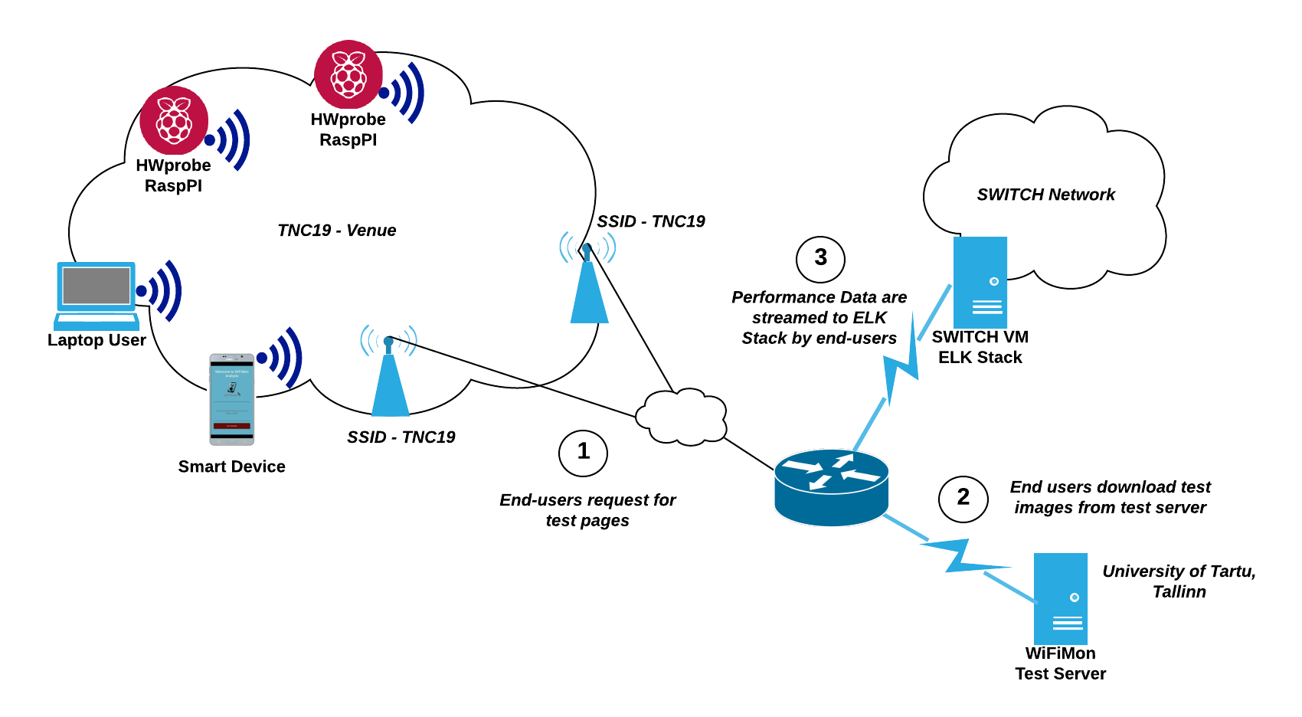
TNC19 Testbed Overview

Slide 15
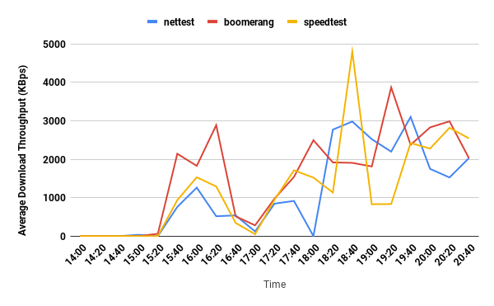
Average Download Throughput in Main Room for H/W probes,
Monday (14.00 - 21.00), including all test tools
Too many lines!
Problem reaching useful conclusions
Infrequent Measurements!
20 minute intervals not ideal
Should increase the frequency

Slide 16
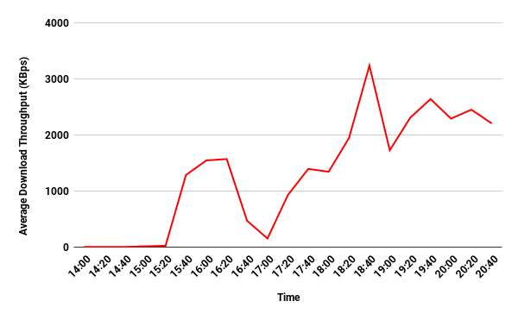
Average Download Throughput in Main Room for H/W probes,
Monday (14.00 - 21.00), Test tools average
WiFi problematic during the lightning talks plenary session (14.00 - 15.20)
WiFi OK in the afternoon when lots of people have left the main room
Worse throughput seen during the opening reception (17.00)
WiFi then OK in the evening

Slide 17
Feedback from TNC19 & 6th SIG-PMV Meeting Audience
Probing period of deterministic h/w probe measurements should be decreased. In the TNC19 pilot it was 20 minutes; for the next pilot we will use 5 minutes. Kibana can aggregate crowdsourced measurements (for the same IP) to specific intervals.
Charts that show more than a single line, e.g., three lines corresponding to the measurements of all the available test tools, can hinder a viewer from reaching quick and useful conclusions.
The WiFiMon dashboard needs to become GDPR compliant, and work needs to be done on RADIUS log privacy.
The WiFiMon Analysis Server & WiFiMon Test Server installation needs to be automated.
Additional information could be extracted from Hardware Probes, e.g., signal strength to detect specific connection problems.

Slide 18
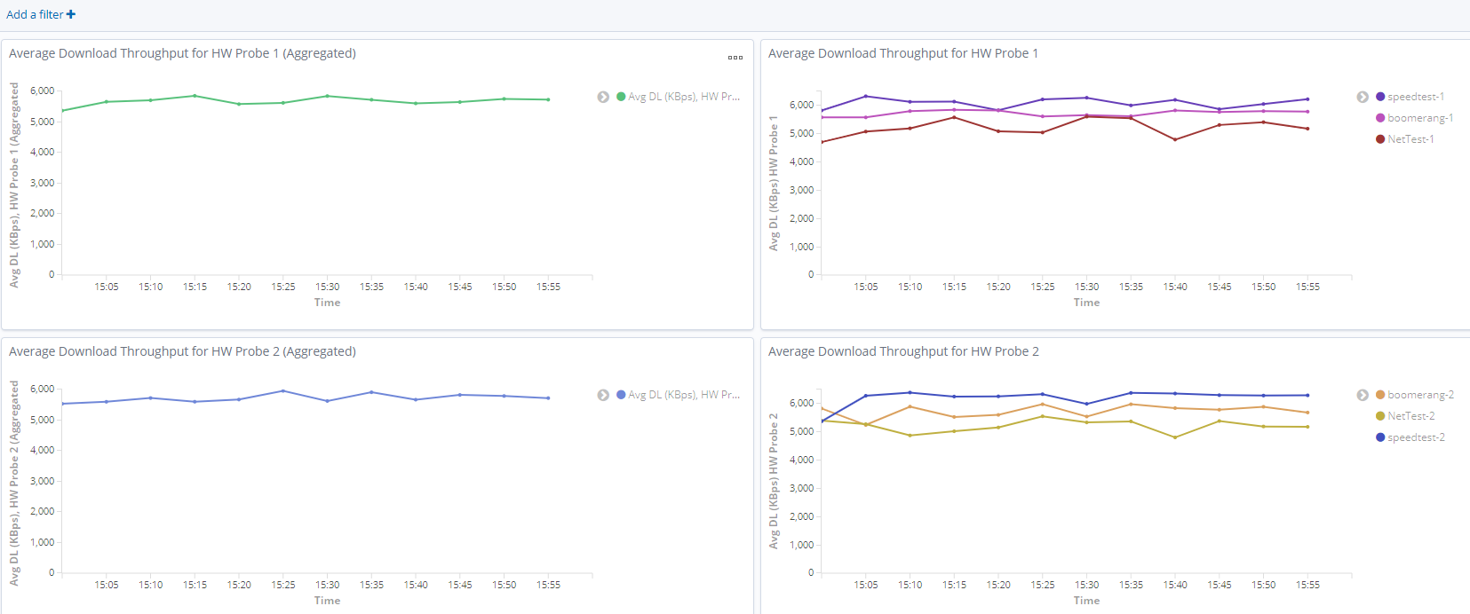
Feedback Integration – H/W Probe (only) Visualisation
All Hardware Probes in one Tab (up: H/W Probe #1, down: H/W Probe #2)
Left Chart: Average of all test tools
Right Chart: Measurements from each test tool (Nettest, Boomerang, Speedtest)

Slide 19
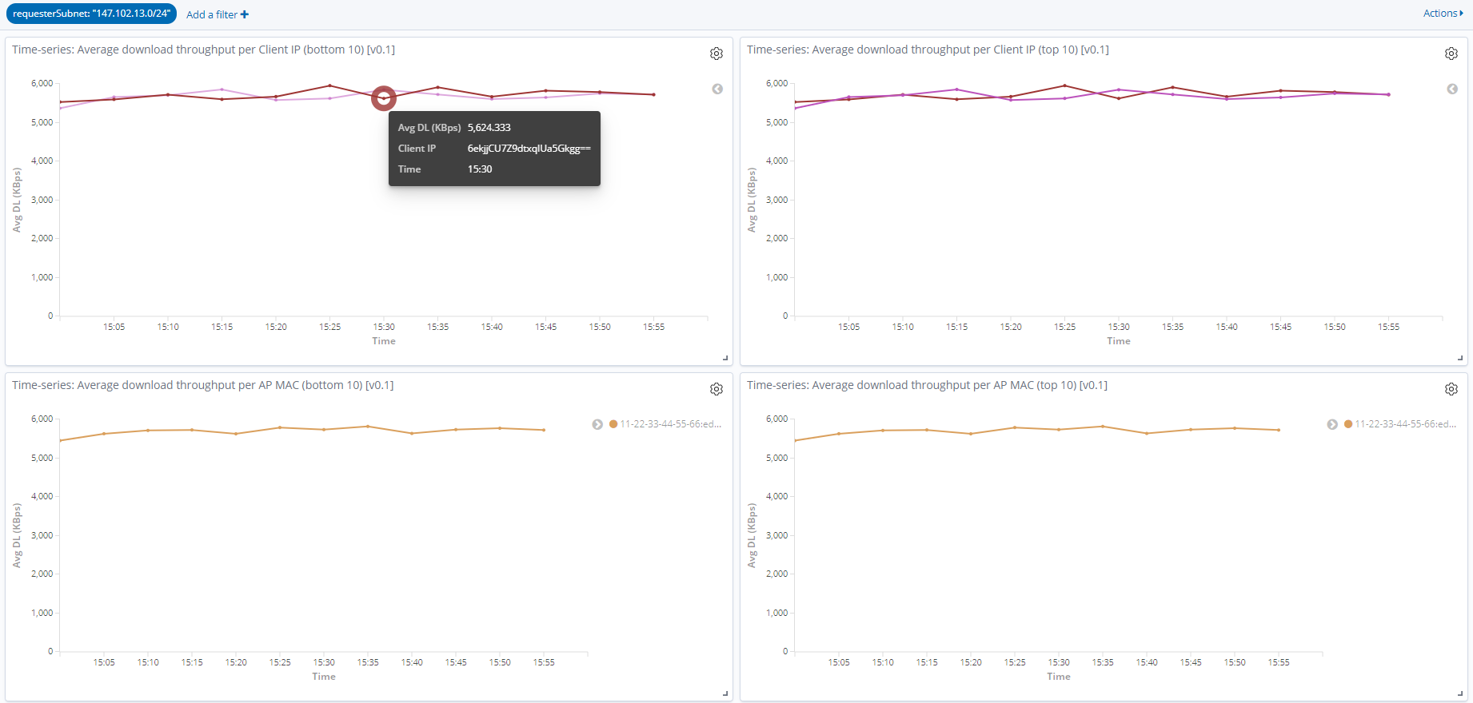
Feedback Integration – Subnets Tab (GDPR Compliance)
Separate Tab view for each monitored subnet.
Client IP & MAC addresses are stored / displayed encrypted with AES-CBC-256 algorithm.
Qualitative Approach: Subnet Administrators do not know which IPs triggered the measurements, but they are interested in the results for their own network (subnets).

Slide 20
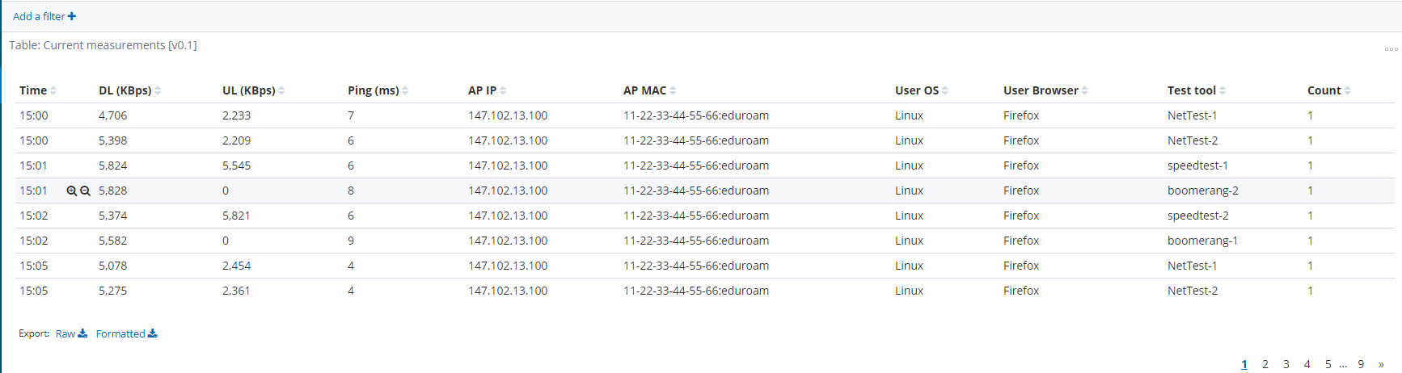
Feedback Integration – Measurements Tab (GDPR Compliance)
Personal Information is removed:
Username (where determinable; this is not required for performance analysis)
Client IP address
Client MAC address

Slide 21
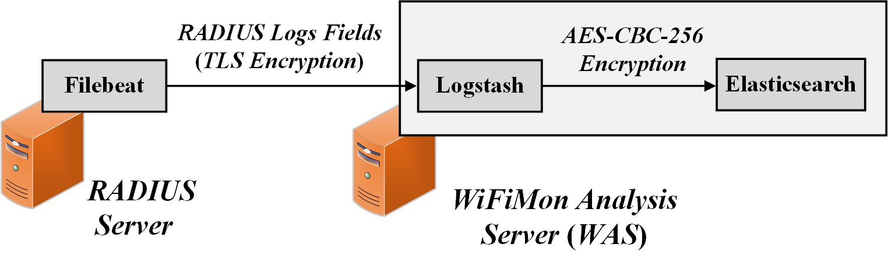
Feedback Integration – RADIUS Logs Privacy
Filebeat: RADIUS logs are streamed encrypted (TLS) to the WiFiMon Agent. Only fields of interest are streamed to reduce total size.
Logstash: RADIUS logs information is encrypted by Logstash using the AES-CBC-256 algorithm. Thus, they are stored encrypted in Elasticsearch.

Slide 22
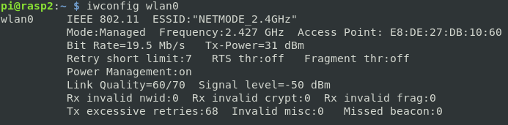
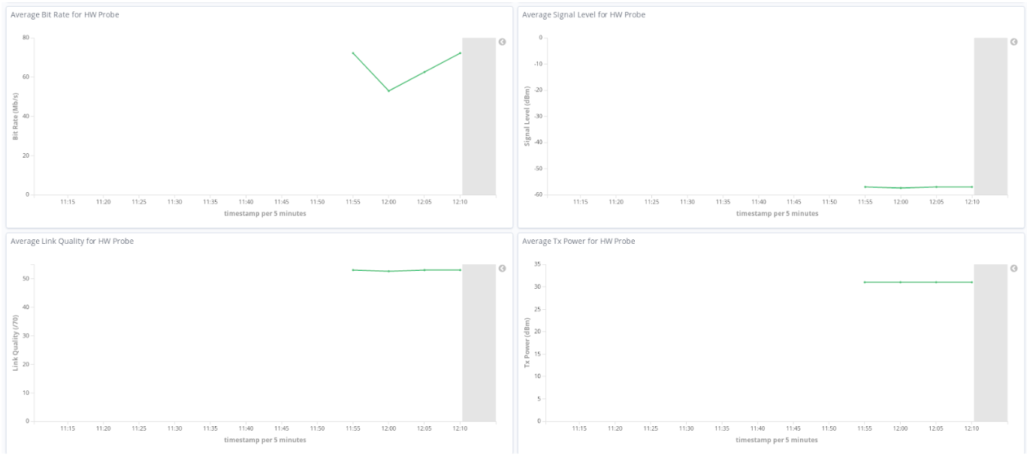
Integration of Additional Information from H/W Probes
Raspberry PI: A simple Python script parses the output of the “iwconfig” command and streams a JSON object to the WiFiMon Analysis Server (WAS) on intervals specified in a crontab
Collected Metrics
Kibana: New visualizations to display the collected metrics per H/W Probe:

Slide 23
Future Work
Automation of WiFiMon Agent & Test Server installation.
WiFiMon Pilot involving end users & RADIUS logs correlation
The WiFiMon Service is planned to be released through the GÉANT GN4-3 project in 2020

